Slide 1
The Muggle Sorting Hat Group 5 Team: Pamela Cerda Bertin, Lea Beiermann, Shofiyyah K. Nisa, Sam Saur Mentor: Jonas Schröder

Slide 2
Agenda
Potential topics for the presentation
Introduction of our project
Idea and Project Outline
Problems & Solutions
Accomplishments until now
Next Steps and Goals

Slide 3
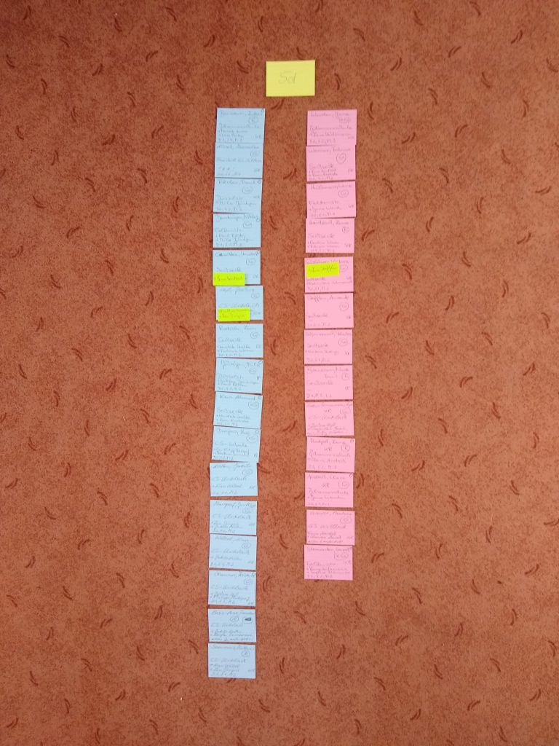
The Muggle Sorting Hat – group 5
The Muggle Sorting Hat :
Teachers have difficulties forming classes of new students, or at least it is very time-consuming. Most teachers still form groups by hand, by writing names on papers and shuffling them around.
Our algorithm will sort students into groups based on various criteria, such as schools, age, friend preference and psychological factors to help create a better learning environment. We will make it easier for the teachers to use our tool with the help of a user-friendly GUI, including e.g. a slider that shows different possible groups.
Picture 1. Example of how teachers form their classes

Slide 4
Idea & Project Outline
Some ideas for this section
What did plan to do in the beginning? We decided to have weekly meetings, then we wanted to create a dataset which we want to scatter into specific groups
How did your planning change during the first weeks? We started off with brainstorming and getting to know github. We looked at different clustering methods and created our dataset
In what stage of the project are you currently?
Deciding if and how we want to cluster our dataset

Slide 5
Problems & Solutions
Some ideas for this section
Explain what your current problems are How to combine clustering and the friend preference How to integrate the personality test into our algorithm How to cluster or if we even should cluster -> groups vs individuals?
How did you manage to find a solution? Work in progress
Are the any specific problems you need help with? How to integrate a personality test into our algorithm

Slide 6
Accomplishments until now
Some ideas for this section
What are crucial steps that you accomplished by now? We finished the dataset We keep brainstorming how to improve our algorithm We have a teacher who provides us with information We successfully tested our theories
How does this impact your project?
We can see our code is working and is able to be implemented

Slide 7
Next Steps and Goals
Some ideas for this section
What is your plan for the upcoming weeks? Implement our clustering ideas, figure out how to implement certain aspects, like the personality tests and the friend preference issue designing an interface
What are the most important steps to finish the project?
Successfully implement our ideas into our algorithm and create a user-friendly interface

Slide 8
Thank you for listening to our presentation. Does anyone have any questions?

